Slide 1
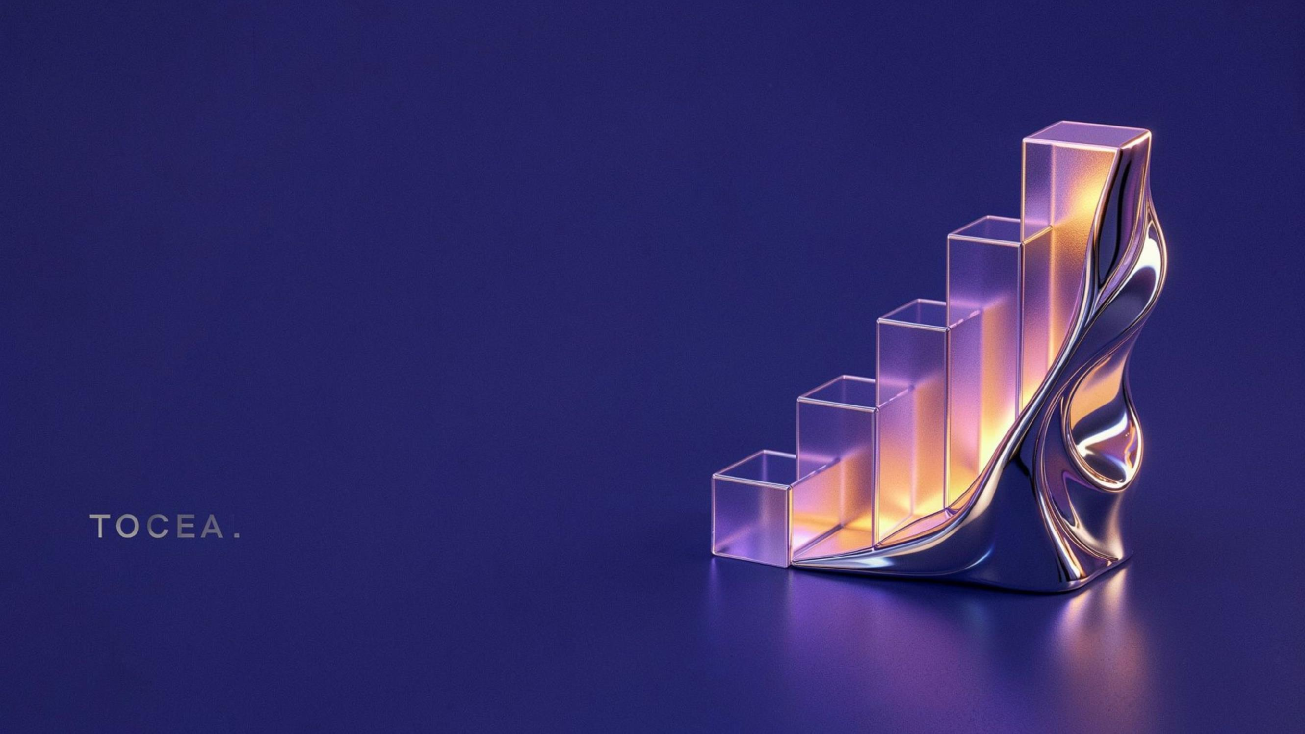


Maze Solver Arena (BFS vs DFS vs Backtracking)
SHIVANSH MISHRA – 25MVCSMR0358
KUNAL MOGRA – 25MVCSMR0320
ROHAN KUMAR SAMAL – 25MVCSMR0349
EMULLA HARSHITH GOUD – 25MVCSMR0303

Slide 2





One maze, three algorithms, visible differences
The same maze makes algorithm behavior easy to observe.
Tool solves one maze using BFS, DFS, and Backtracking.
Pathfinding supports games, robots, and GPS navigation.
One app shows side-by-side algorithm results.
Students see how algorithm choices change behavior.

Slide 3



Compare paths, effort, and execution
Generate or accept a maze, then run three solvers.
Compare path length, cells visited, and execution time.
Implement, visualize, and explain all three algorithms.
S COP E
Scope: grid mazes with four-direction movement.
USERS
Users: students, teachers, and algorithm learners.

Slide 4
Features keep experiments simple and repeatable
01
Generate random mazes using size, loops, and seed.
02
Paste a custom maze for testing.
03
Show comparison tables and bar charts.
04
Animate steps with a play button.
05
Validate one S, one E; step limit prevents endless backtracking.
Python 3.12 and a browser are required. No login or database.

Slide 5
Each solver follows a different search strategy
Input maze
Run three solvers
Record path, visited cells, and time
Compare results
Visualize the findings
BFS uses a queue; it finds shortest paths in O(V+E).
DFS uses a stack; it goes deep and may be longer.
Backtracking chooses, checks, and undoes; worst case is exponential.
Maze is a grid graph; randomized DFS generates it.

Slide 6
Simple architecture, focused implementation
Python powers algorithms and application logic.
Streamlit provides the interactive user interface.
Matplotlib draws animations and charts.
Pandas creates comparison tables; NumPy supports grid operations.
maze.py contains algorithms; app.py contains interface.
ARC HI TEC TURE
User Streamlit UI Solvers
Architecture: User → Streamlit UI → Solvers → Results → Charts. No database.
Results
Charts

Slide 7
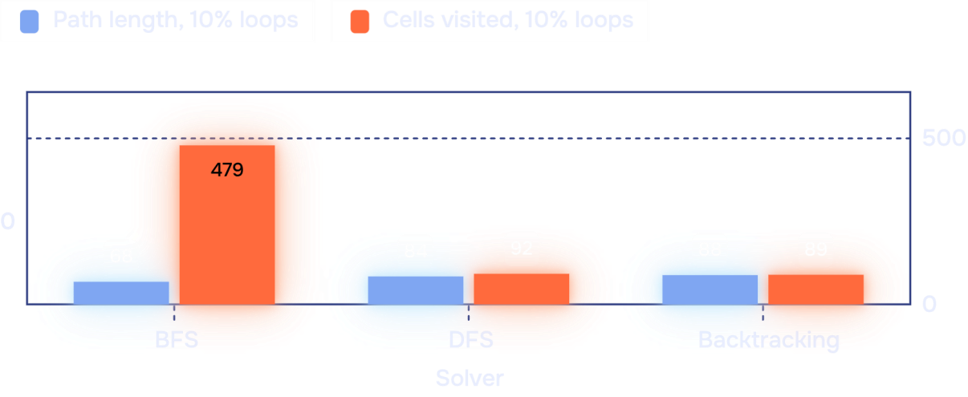
BFS wins path length; DFS may visit fewer cells
Maze | Solver | Cells visited
No loops | BFS | 219
No loops | DFS | 191
No loops | Backtrackin g | 439
31×31 maze, seed 7, no loops: all paths measure 180 steps.
10% loops: BFS 68 steps / 479 cells.
Test perfect, looped, no-path, invalid, large, and step-limit mazes.
10% loops: DFS 84 steps / 92 cells.
Complexity table: compare time and space for all three algorithms.
10% loops: Backtracking 88 steps / 89 cells.
Screenshots: [comparison table] and [animation]

Slide 8





Conclusion: choose the solver for the goal
08
BFS is best when shortest path matters most.
DFS can reduce exploration in some maze layouts.
Backtracking clearly shows choose-
check-undo behavior.
The tool makes abstract complexity
easy to observe.
Next step: demo one maze and discuss the results.

